Slide 1
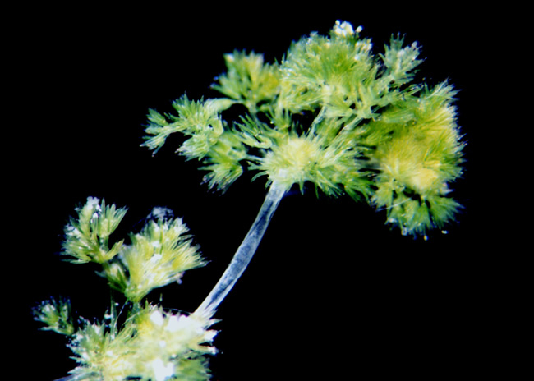
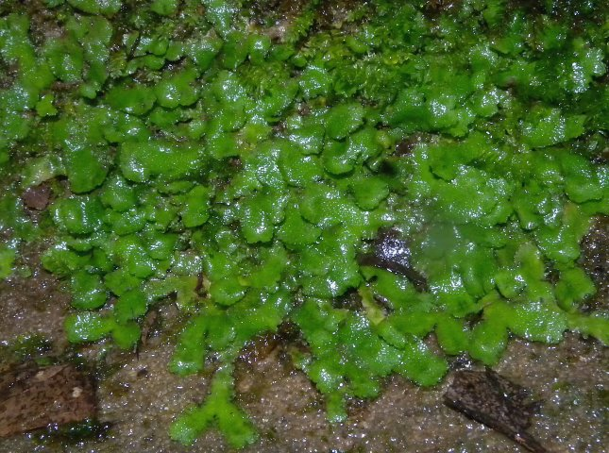
How plants colonized land

Slide 2
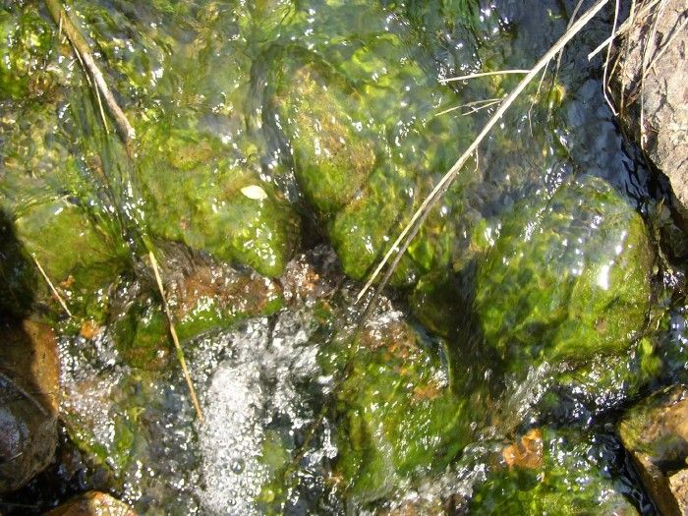
Early life on land
First organisms on land were likely cyanobacteria, prokaryotes, and protists
These likely existed in biofilms - a mix of microorganisms that stick to each other in a slimy extracellular matrix

Slide 3
Land plants appear about 470 MYA
First plants were nonvascular and quite small, a few cm tall at most
Dominant terrestrial plant life on Earth for 85 million years

Slide 4
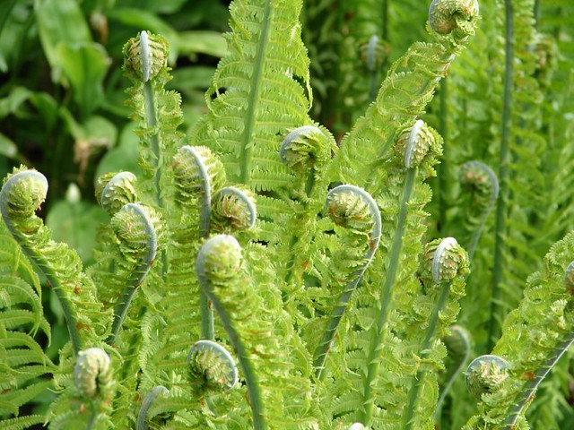
A new kind of plant appears
Grew taller than just a few cm
Soon became the dominant plant life form on the planet
Notes:
Ferns

Slide 5
How plants colonized land

Slide 6
Learning Goal
Explain and provide evidence for the theory that plants evolved from a lineage of green algae

Slide 7
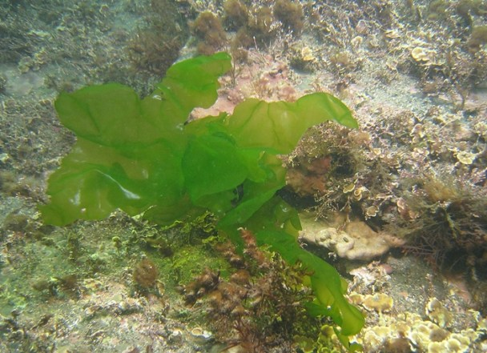
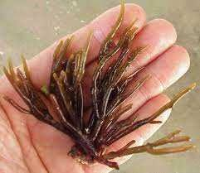
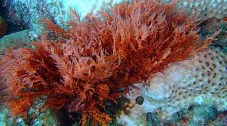
Shared similarities between plants and algae
Plants are multicellular, eukaryotic, photoautotrophs
Brown, (most) red, (some) green algae are as well

Slide 8
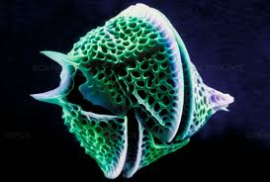
Shared similarities between plants and algae
Plants have cell walls made of cellulose
Brown algae, green algae, and dinoflagellates are as well

Slide 9
Shared similarities between plants and algae
Plants have chloroplasts with chlorophyll a and b
Euglenids, green algae, and (some) dinoflagellates are as well

Slide 10
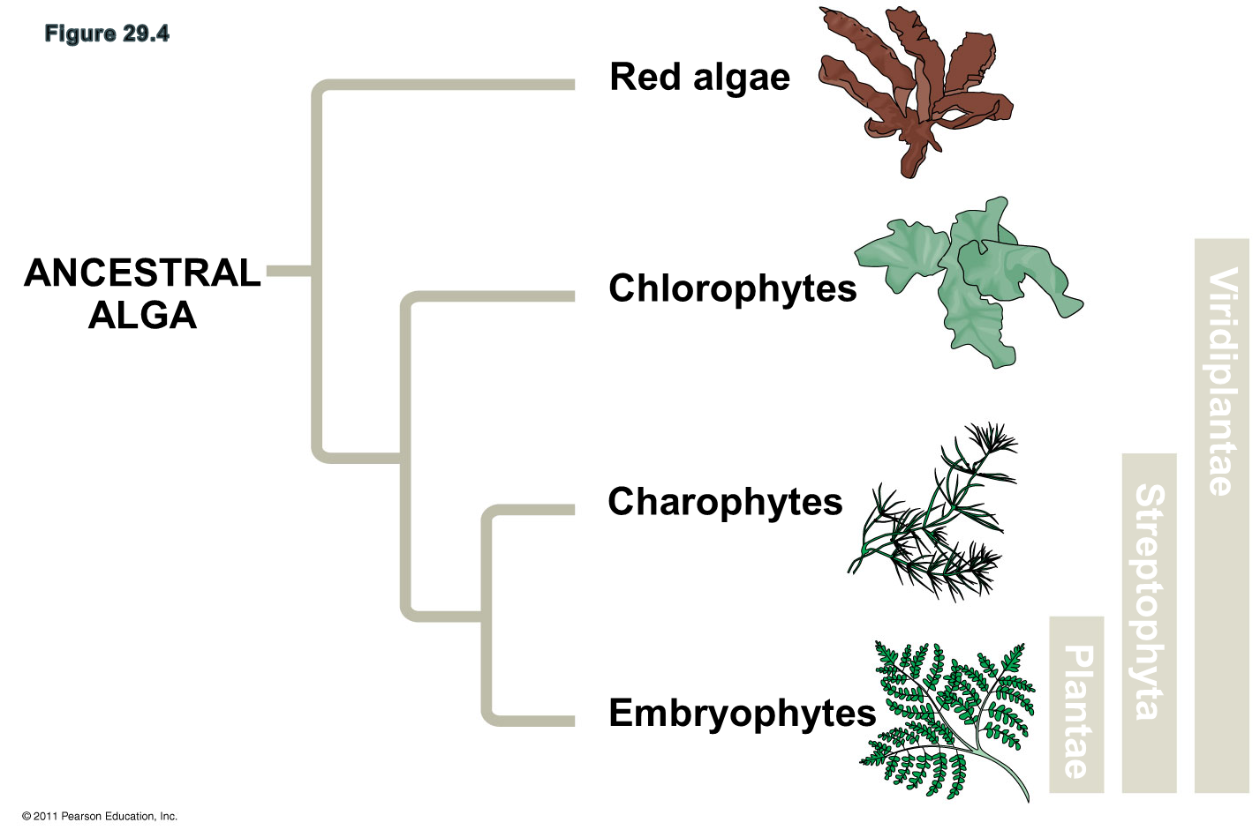
Shared similarities between plants and algae
Only the protist supergroup Archaeplastitida, and specifically, the Charophytes, has all of these traits in common with plants

Slide 11
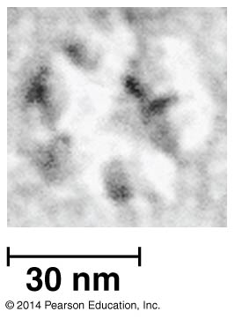
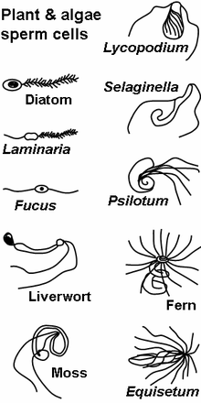
Shared similarities between plants and Charophytes
Rings of cellulose-synthesizing proteins in plasma membrane
Shared structure of flagellated sperm

Slide 12
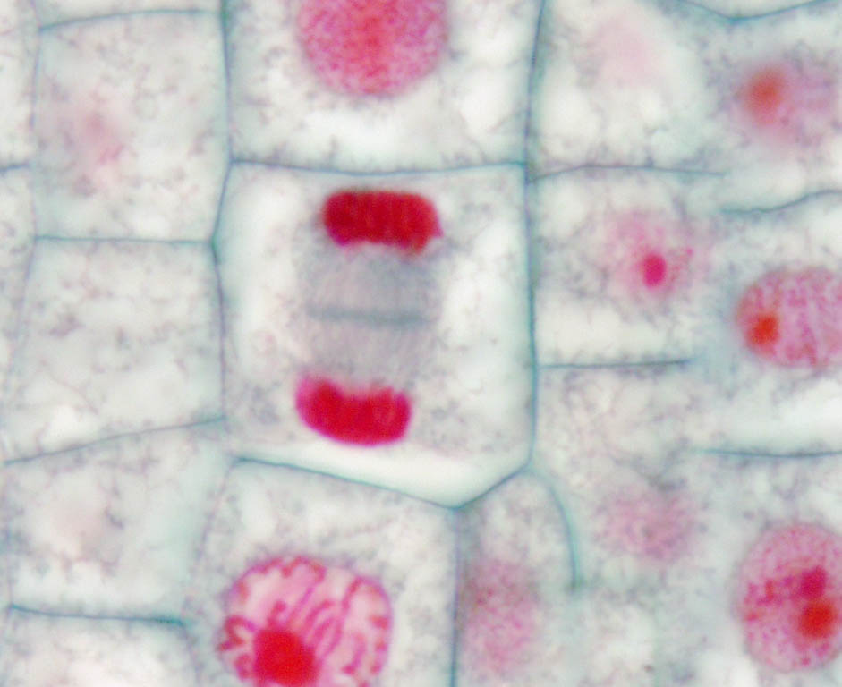
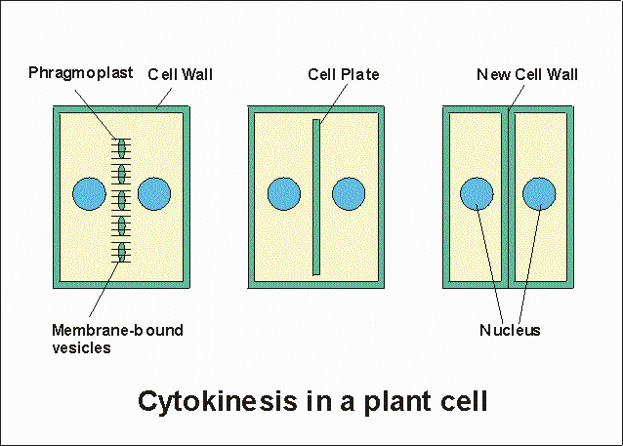
Shared similarities between plants and Charophytes
Presence of of phragmoplasts during cell division
DNA evidence (shared homologies)

Slide 13
Traits present in plants, absent in charophytes
Plants have several features that (1) define them as plants, and (2) distinguish them from charophytes. We cover just four.
Multicellular dependent embryos retained within the parent tissue
Apical meristems

Slide 14
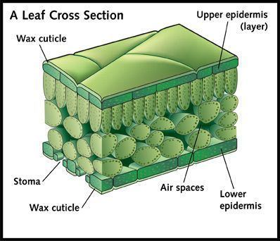
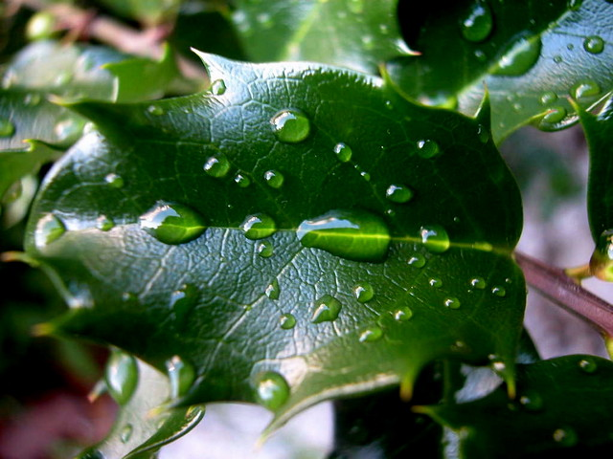
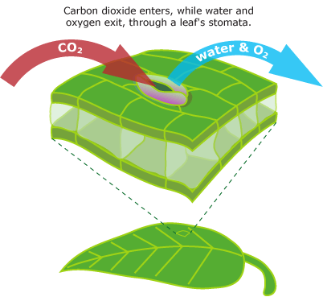
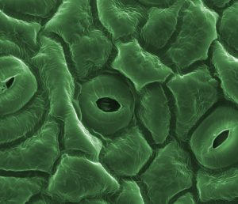
Traits present in plants, absent in charophytes
Cuticle - waxy covering on epidermis that reduces water loss
Stomata - support photosynthesis by allowing exchange of CO2 for O2

Slide 15
Costs and benefits of life on land
Benefits
Light is abundant
Higher carbon dioxide concentrations
Costs
Water is scarce
Lack of structural support

Slide 16
How plants colonized land

Slide 17
Learning Goal
Know the three phyla of bryophytes, their distinguishing traits, and their phylogenetic relationship to other plants

Slide 18
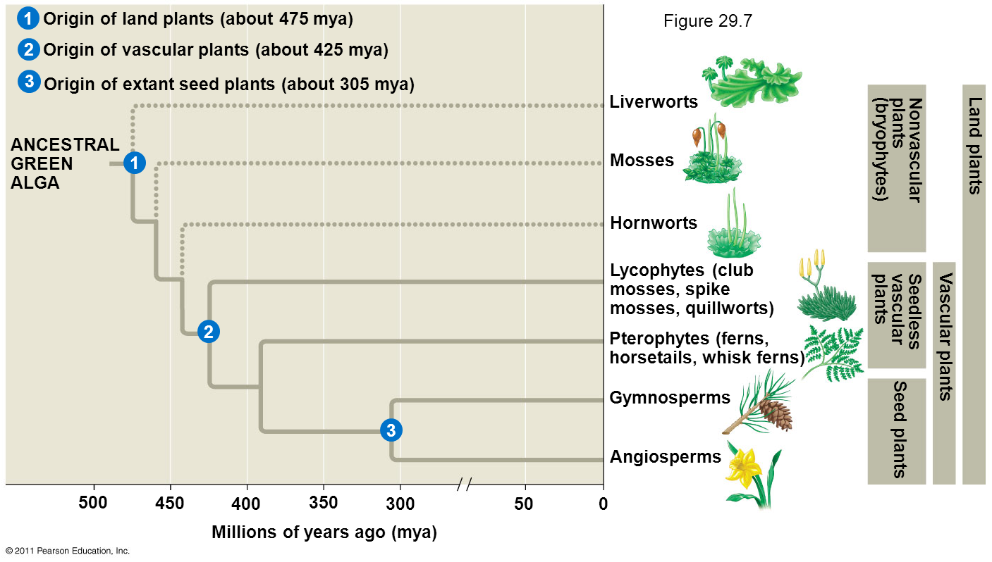
Bryophytes share a common ancestor with vascular plants

Slide 19
Characteristics common to bryophytes
Exhibit alternation of generations, with gametophyte as the dominant stage
Lack vascular tissue, so they are unable to transport water or nutrients long distances
Lack roots. Rhizoids (long single cells or filaments of cells) anchor plant. No major role of rhizoids in water or nutrient uptake.

Slide 20
Liverworts
Small, flattened plants seldom larger than 20 mm
About 7500 species worldwide
Lack differentiated stem and leaves
Most grow in moist shady areas
Oldest known fossil liverworts are 470 MYA

Slide 21
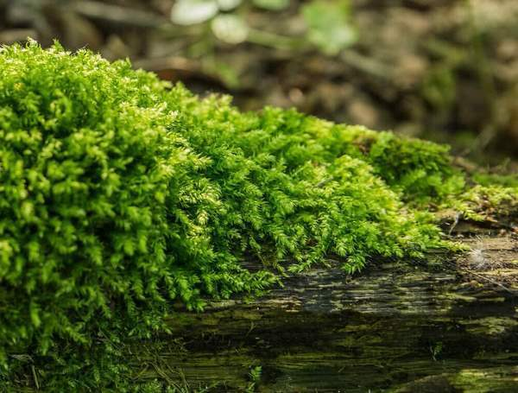
Mosses
Short, reach heights of 10 cm
About 12,000 species worldwide
Have simple leaf-like structure 1 cell thick, attached to a stem-like structure
Most grow in moist areas or shady areas
Do not fossilize well, oldest known are 340 MYA

Slide 22
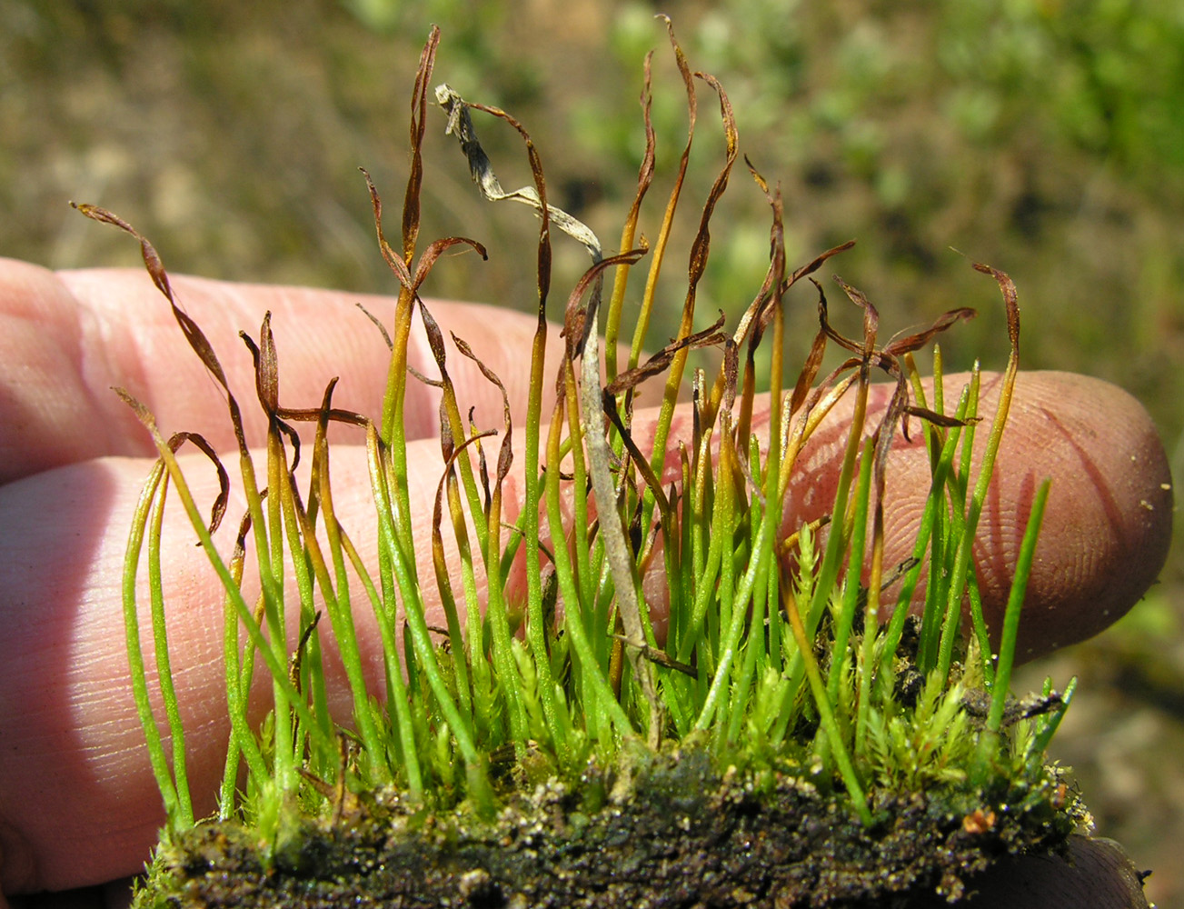
Hornworts
Short, reach heights of 5 cm
About 200 species worldwide
Most grow in moist shady areas
Do not fossilize well, oldest known are 70 MYA

Slide 23
How plants colonized land

Slide 24
Learning Goals
Describe the life cycle of bryophytes (nonvascular plants)

Slide 25
Bryophyte life cycles are challenging to understand
Undergo an alternation of generations
Gametophyte (haploid n)
Sporophyte (diploid 2n)
Gametophyte reproduction gives rise to sporophyte individuals
Sporophyte reproduction gives rise to gametophyte individuals

Slide 26
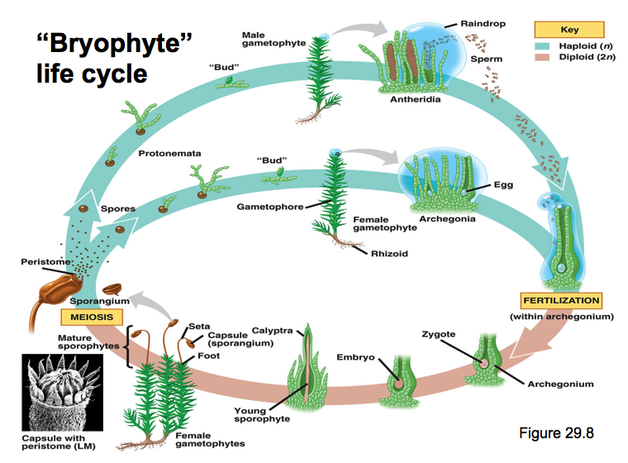
Bryophyte life cycle
A mature sporophyte releases spores
Spores are haploid (n)
Develop into male or female gametophytes

Slide 27
Bryophyte life cycle
Gametophyte spores develop into a threadlike protonemata
The protonemata produce budlike structures that grow into gametophores
Gametophyte is the protonemata + gametophores

Slide 28
Bryophyte life cycle
Sperm are produced in antheridia found at the tips of the bryophyte
They swim through a film of moisture to fertilize an egg in the archegonia of the bryophyte. The fertilized egg is diploid (2n) and the sporophyte generation begins

Slide 29
Bryophyte life cycle
The sporophyte zygote developer in the archegonium.
The young sporophyte grows a long stalk (seta) that emerges from the archegonium.
The sporophyte remains physically attached to the gametophyte

Slide 30
Bryophyte life cycle
The sporophyte produces a capsule that produces haploid spores (n) by meiosis.
Spores are released, germinate, and the gametophyte generation begins

Slide 31
Gametophyte is dominant
When we look at a bryophyte, we are might just be looking at the gametophyte stage
The sporophyte cannot be present without the gametophyte. You never see sporophytes without gametophytes

Slide 32
How plants colonized land

Slide 33
Learning Goals
Know the major evolutionary innovations of seedless vascular plants, how their life cycle differs from bryophytes, and representatives of the two phyla seedless vascular plants

Slide 34
Seedless vascular plants share a common ancestor with hornworts

Slide 35
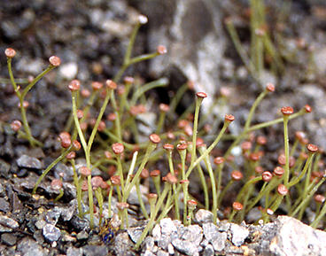
Seedless vascular plants have a number of traits that separate them from bryophytes
Evolution of vascular tissue (xylem, phloem)
Evolution of roots
Evolution of leaves
Cooksonia, a reconstruction of the oldest vascular plant known from the fossil record

Slide 36
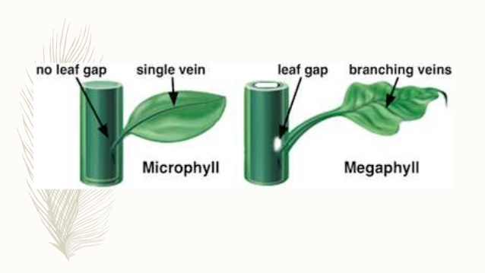
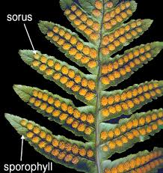
Seedless vascular plant
leaf types
Microphylls - small leaves supported by a single strand of vascular tissue
Megaphylls - leaves with a highly-branched vascular system
Sporophylls - modified leaves that bear spores

Slide 37
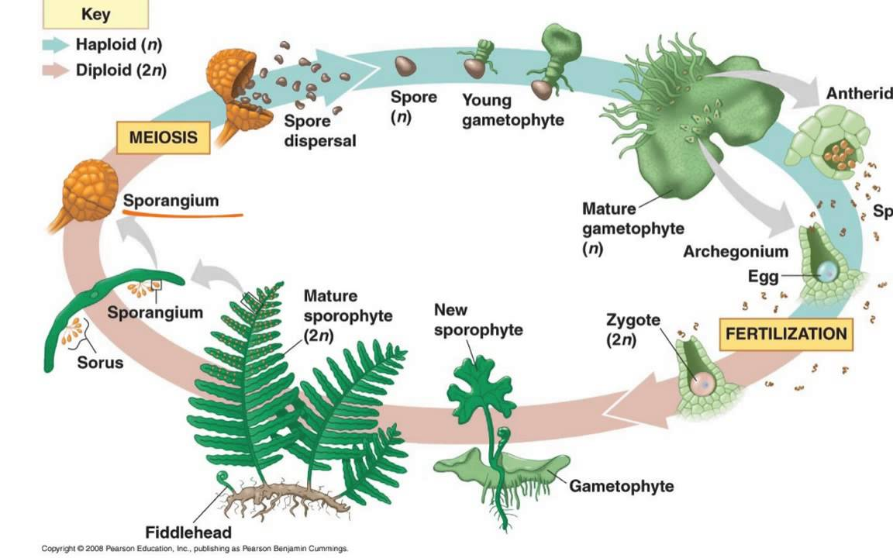
Seedless vascular plant
life cycle
Exhibit alternation of generations
One key difference between this life cycle and the bryophyte life cycle—Sporophyte is dominant

Slide 38
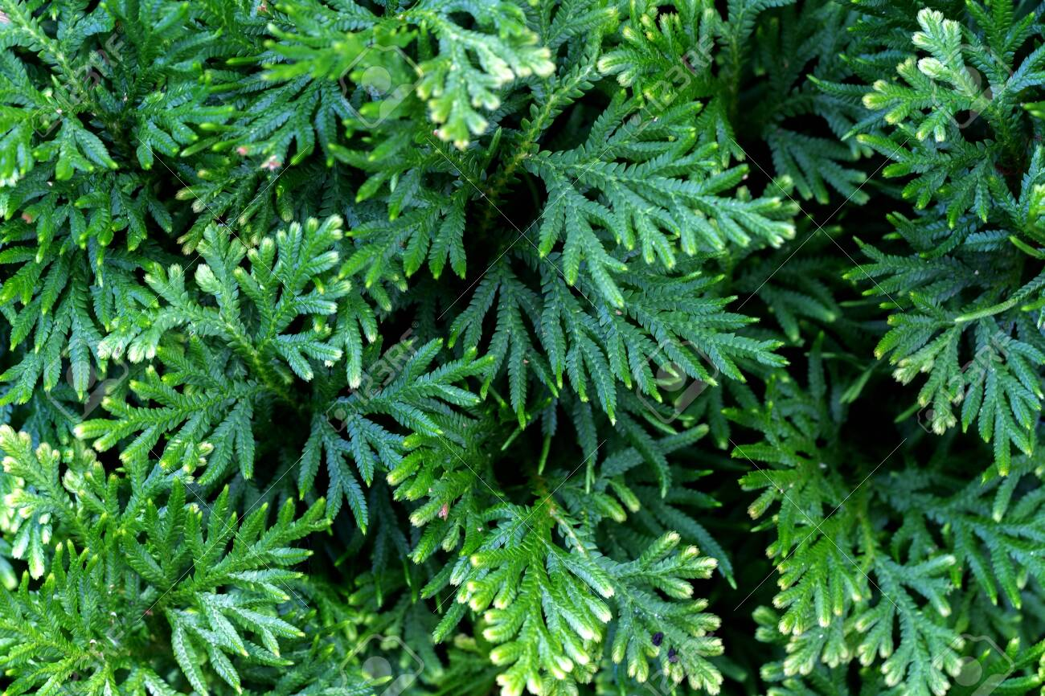
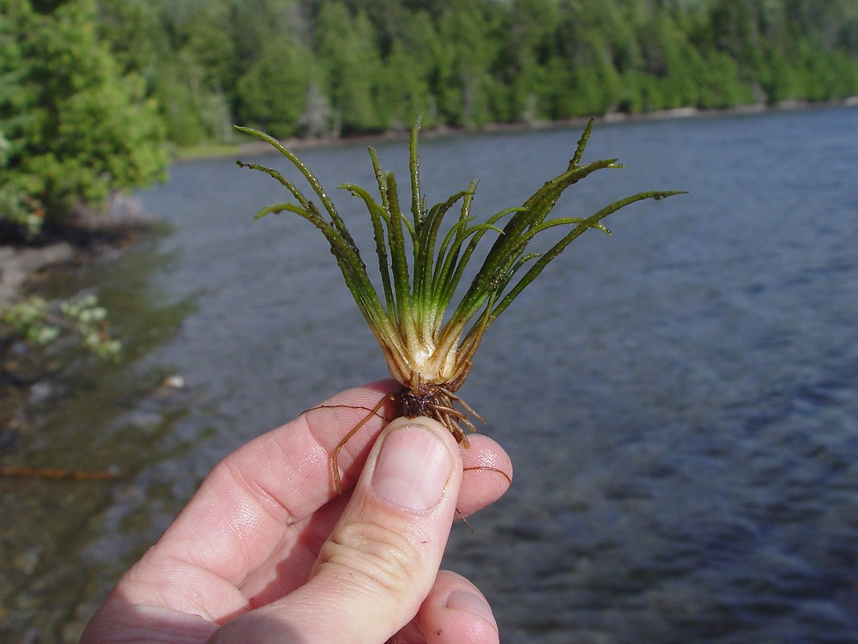
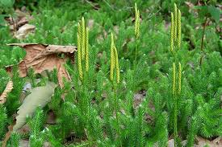
Phylum Lycophyta (Lycophytes)
Includes club mosses, spikemosses, quillworts
Only seedless vascular plant to have microphylls
About 1200 species

Slide 39
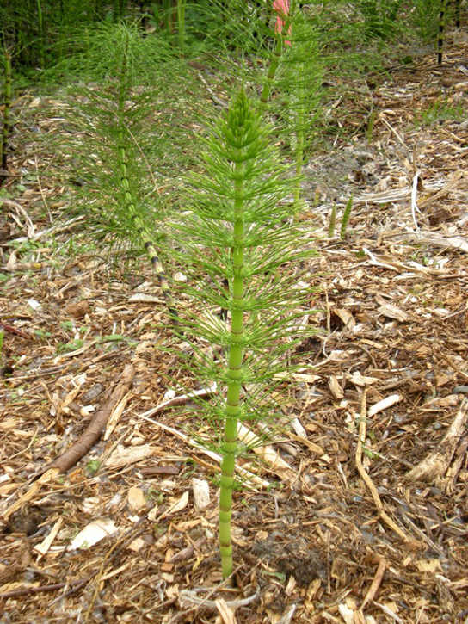
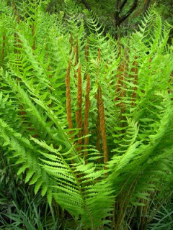
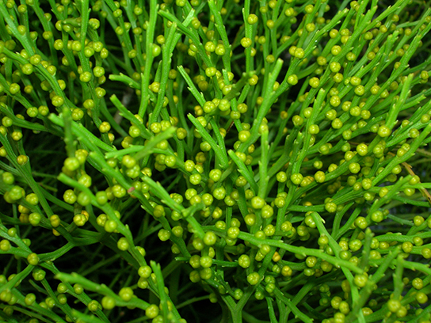
Phylum Monilophyta
(Pterophytes)
Includes ferns, horsetails, and whisk ferns
10,000+ species

